Slide 1


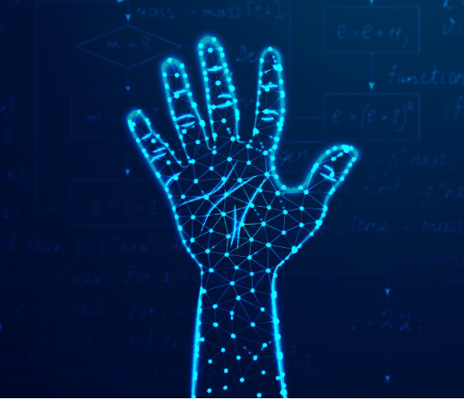
AI-Based Invisible Gesture Unlock System for Secure File Access
Kodavati Jahnavi Sai Satya- 192372312

Slide 2
Introduction
Gesture Recognition : Technology where a sensor detects human body movements and converts them into input commands to control devices.
It is a security system that allows users to unlock access using hand gestures instead of passwords or PINs.
The system works by detecting invisible directional gestures using a gesture sensor connected to an Arduino Uno microcontroller.

Slide 3
Problem Statement
Password Issues
Easily hackable, guessable, and prone to shoulder surfing.
Finger print
Fails with wet, dirty, or damaged fingers and requires physical touch.
Face Recognition
Affected by lighting, masks, angles, and poses privacy risks
Iris Detection
Needs the user to be very close, struggles with eyeglasses, reflections, and feels uncomfortable for many users.

Slide 4
Architecture
LED Output
(Green / Red)
Arduino Uno Microcontroller
Gesture Processing
File Access
Control
(Unlock / Lock Files)
Gesture Sensor
APDS - 9960
Authentication
Wi-Fi Module
(SMS Alert)

Slide 5
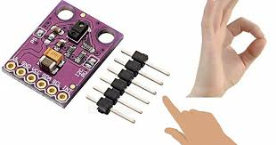
Module 1:
Gesture Recognition

Slide 6
APDS9960 :
A compact optical sensor with IR-based gesture recognition, proximity, color, and light sensing, using a four-photodiode array and I2C communication.
Dynamic Hand Interaction
User performs a directional hand gesture.
Infrared Emission
APDS-9960 emits infrared light. Four photodiodes detect variation in IR reflection.
Gesture Interpretation
Calculates gesture from the order and strength of reflected IR light
Seamless I2C Communication
Gesture Digital Transfers data to Arduino Uno via I2C protocol using SCL and SDA .
(Up, Down, Left, Right)

Slide 7
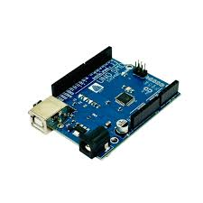
Module 2:
Authentication and Security

Slide 8
Arduino Uno :
Arduino IDE +SparkFun APDS9960 library are used to read and capture the gesture sequence
Arduino Uno (programmed using Arduino IDE) compares the received gesture with the predefined pattern stored in the code.
Dynamic Access Authorization
Arduino Uno sends Access Granted → Green LED ON. (File Unlock) Sends Access Denied → Red LED ON.
Arduino Uno supports I2C for real-time processing ( Serial Communication) , wireless communication, and IoT applications.
Gesture Data
Reception
Pattern Verification

Slide 9

Module 3:
File Access Management

Slide 10
Lock Mode Activation :
1. Authentication Result Transmission
2. Lock Mode Activation (After 3 Wrong Attempts)
3.
3. SMS Alert Notification
Arduino Uno sends Access Granted or Denied signals to the PC through Serial Communication (USB).
Python script reads and captures data from Arduino Uno for further action.
Arduino Uno activates Lock Mode for 2 minutes.
During Lock Mode, Arduino Uno disables gesture input temporarily and sends Lock Status to the PC.
When Lock Mode is triggered, Arduino Uno connects to Wi-Fi.
Sends an SMS alert to the user’s phone notifying “Unauthorized Attempt Detected”.

Slide 11
Project Demo

Slide 12
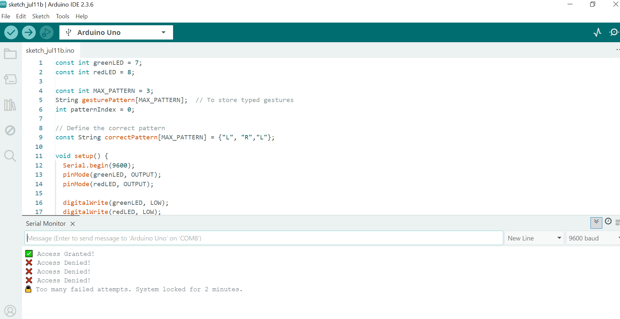
Simulation:

Slide 13
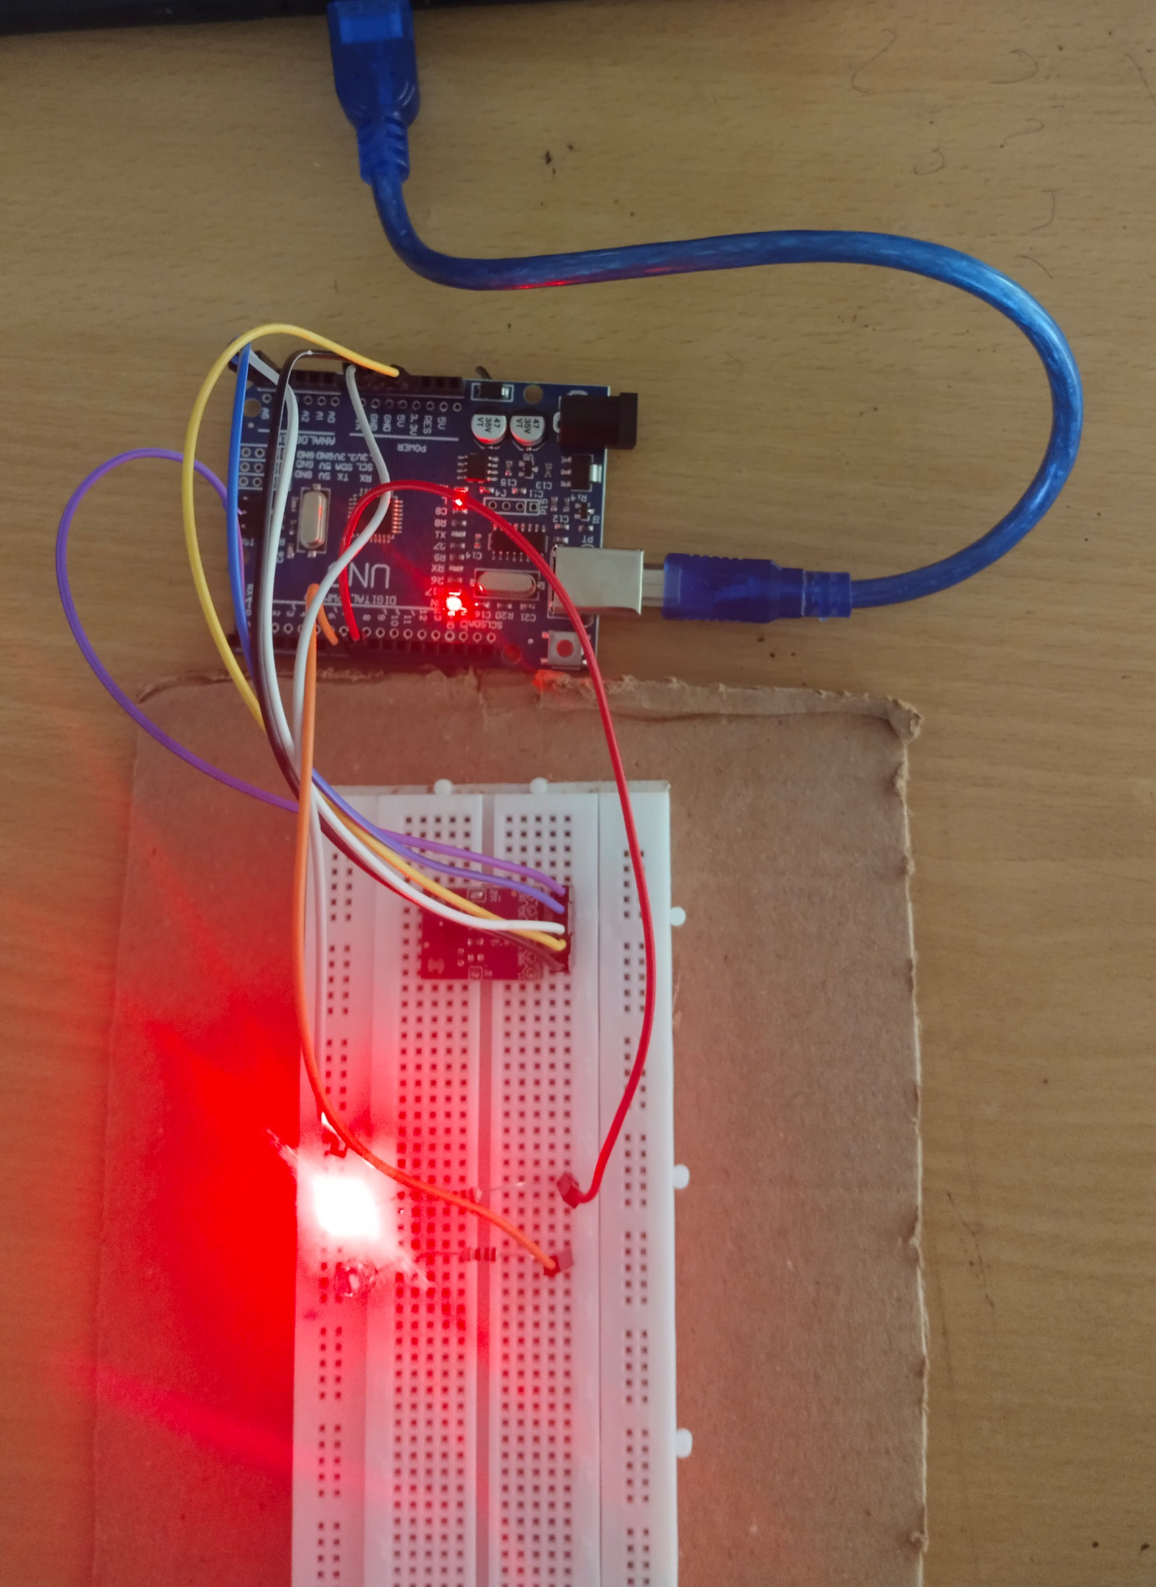
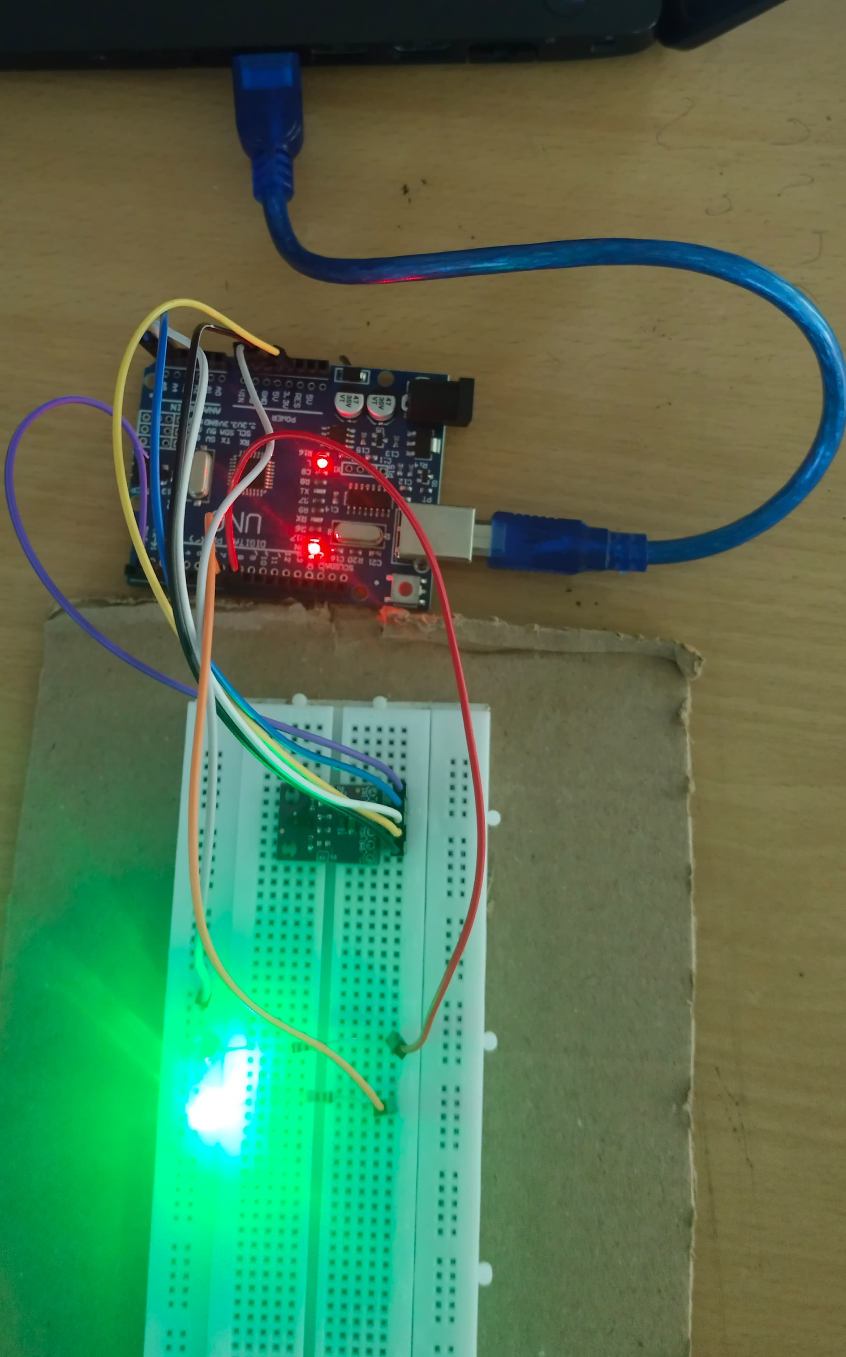
Access Denied
Access Granted

Slide 14
Conclusion
Arduino Uno with APDS-9960 sensor efficiently detects gestures and makes instant access decisions with reliable output.
The system includes automatic lock mode and SMS alerts after multiple wrong attempts, ensuring proactive security.
Provides a complete end-to-end file protection system, from gesture detection to file unlocking or locking on the PC, with clear LED and digital feedback.
Successfully replaces passwords with invisible gesture-based authentication, enhancing privacy and security.

Slide 15
Future Scope
Integration with Smart Devices : Can be extended to unlock smart locks, doors, safes, and IoT-based home automation systems.
AI-Based Gesture Learning : Implement machine learning models to recognize custom gestures, improving accuracy and personalization.
Cloud-Based Access Logs : Store access history, alerts, and attempts on the cloud, allowing remote monitoring and management.
Mobile App Integration : Develop a dedicated mobile app to manage gestures, receive alerts, change patterns, and monitor security status in real-time.

Slide 16


